Slide 1




Alcohol policy reform
in Latvia
Policy reform
Recent changes
Implementation
Recent changes, early signals and next steps
First lessons
Next steps
Where Latvia may go next
Ginta Egle
Senior Expert
Department of Mental Health, Addiction Prevention and Integrated Services
LATVIA
Ministry of Health
NDPHS Expert Group on Alcohol and Substance Use (ASA EG)
Tallinn, Estonia | 17 June 2026
NDPHS ASA EG 30 · Tallinn · 17 June 2026

Slide 2
MINISTRY OF HEALTH OF LATVIA
SECTION 01
Policy context and the 2025 reform package
Why Latvia changed its alcohol policy and what entered into force in 2025.
01
NDPHS ASA EG 30 • Tallinn • 17 June 2026
02

Slide 3
MINISTRY OF HEALTH OF LATVIA
Why alcohol policy remaines a public health priority
The reform responds to a high public health burden and a need for population-level measures.
11.3 litres
Alcohol is highly normalised
Drinking is widely seen as a normal part of everyday life, social occasions and celebrations.
registered absolute alcohol
consumption per inhabitant
aged 15+ in 2024
Public attitudes remain favourable
A large part of society still views alcohol positively, which weakens support for stronger restrictions.
Policy rationale
High consumption
Preventable harm
Need for population-level
measures
Industry lobbying is strong
The alcohol and hospitality sectors actively challenge new measures and shape the public debate.
NDPHS ASA EG 30 · Tallinn · 17 June 2026
03

Slide 4
MINISTRY OF HEALTH OF LATVIA
TIMELINE + POLICY PACKAGE
What changed in 2025: from adoption to implementation
2023–2024
9 Jan 2025
1 Aug 2025
2025–2026
By 31 Oct 2026
Evidence
Adoption
Entry into force
Implementation
Evaluation
Reducing availability
Marketing and sales promotion
• Shorter retail sales hours.
• Minimum 6-hour delivery delay for distance sales.
• Alcohol may not be sold or consumed at gambling equipment.
• Multi-pack / “2-for-1” type discount offers restricted.
• Alcohol may not be offered within loyalty programmes.
• Price and discount advertising is banned.
• Sales promotion practices are banned.
NDPHS ASA EG 30 · Tallinn · 17 June 2026
04

Slide 5

MINISTRY OF HEALTH OF LATVIA
AVAILABILITY
Reducing immediacy of access
Retail hours and online delivery are presented together because both target impulse purchasing.
Retail sales hours
Distance sales
Mon–Sat
Sunday
10:00–20:00
10:00–18:00
1
2
3
Order placed
Minimum wait
6 hours
Delivery
Requires monitoring of platforms, couriers and age-verification practices.
NDPHS ASA EG 30 · Tallinn · 17 June 2026
05

Slide 6
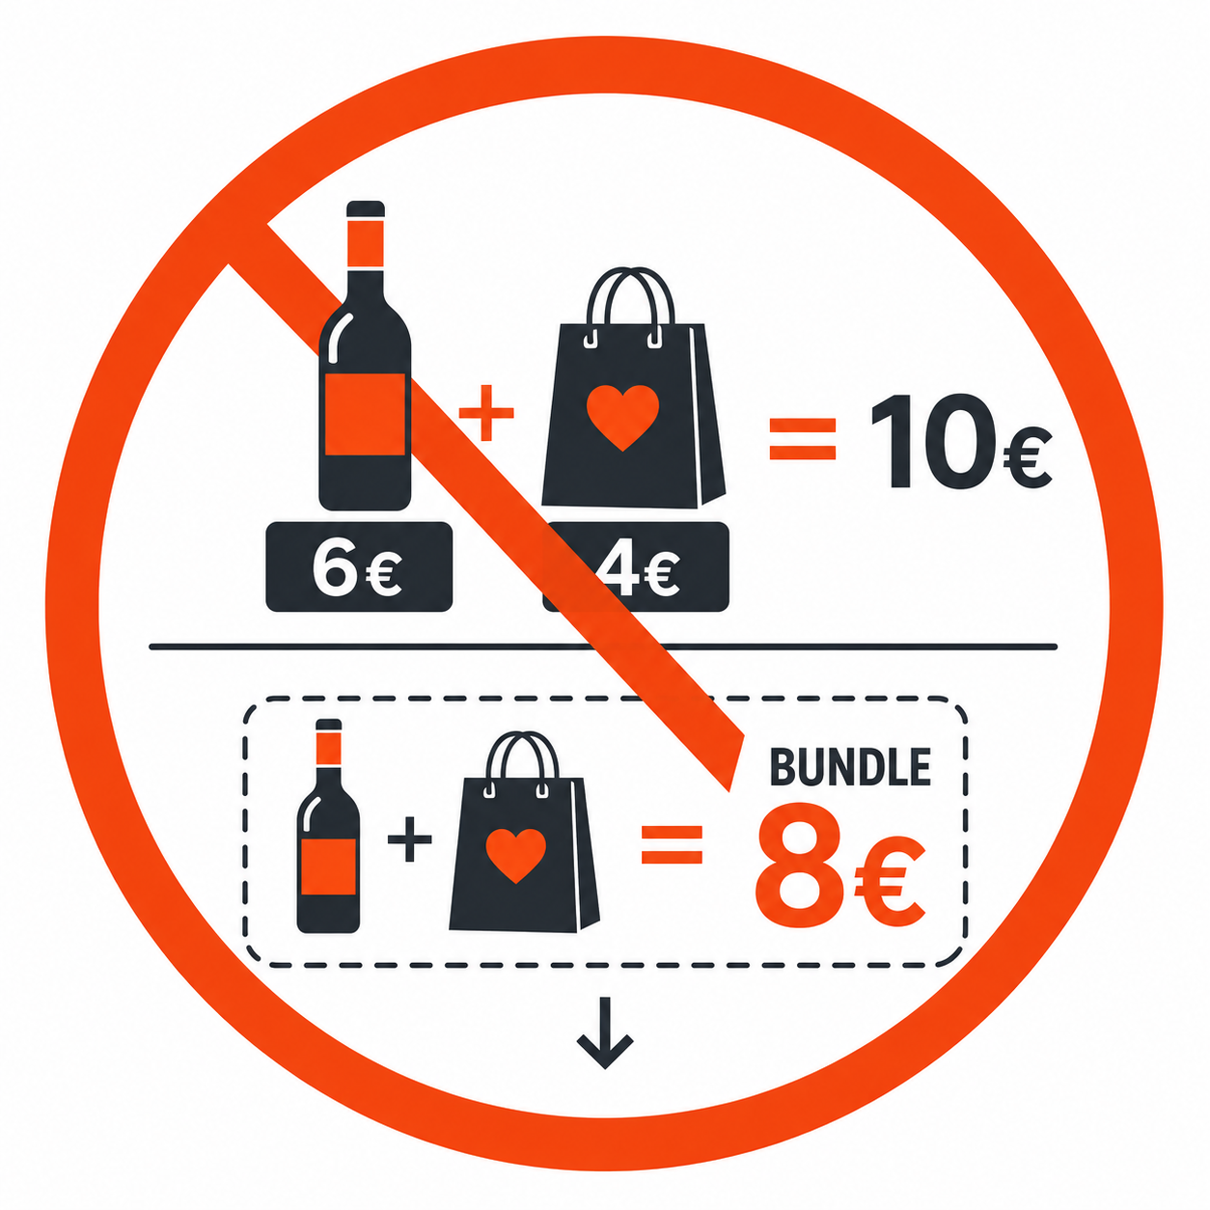
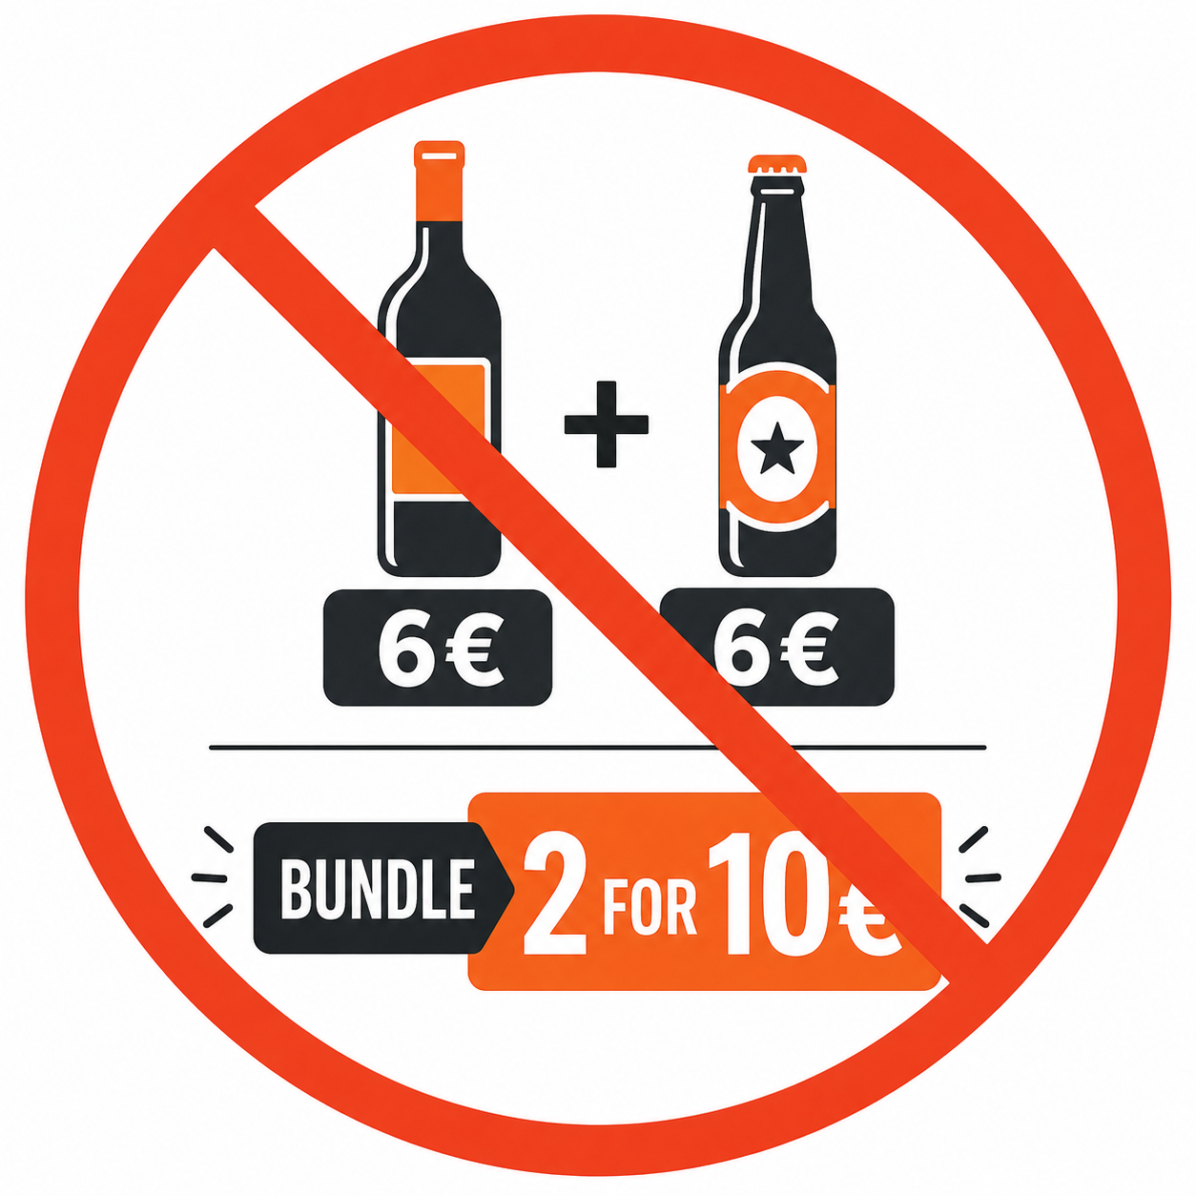
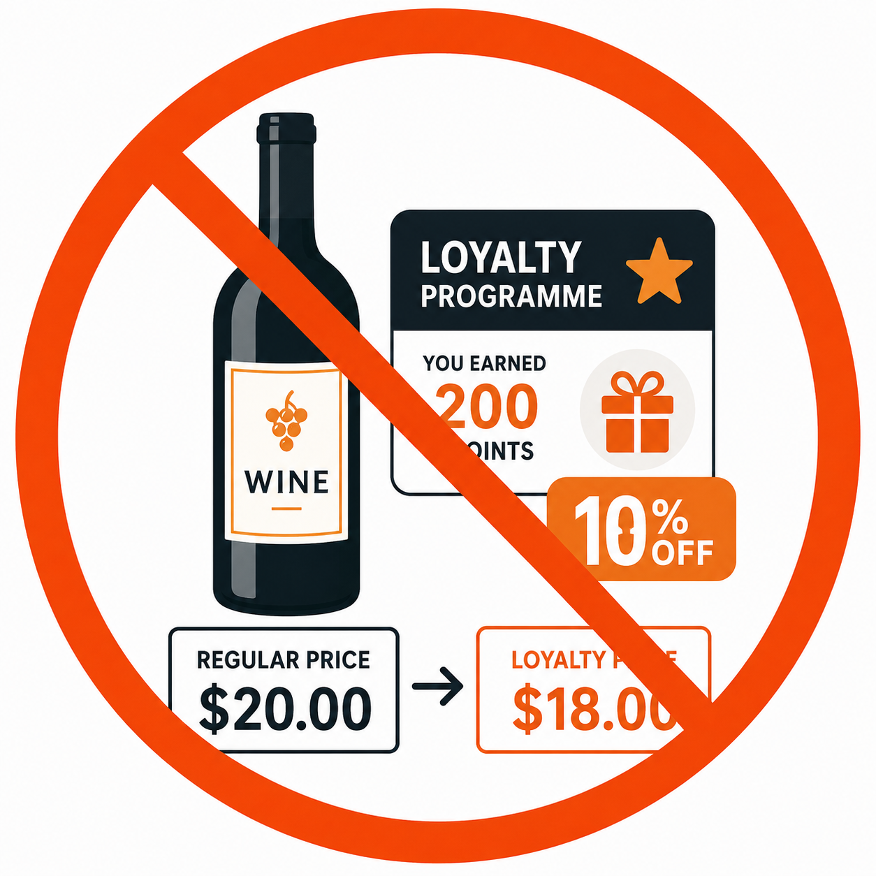
MINISTRY OF HEALTH OF LATVIA
MARKETING
Marketing and price promotion restrictions
Sales promotion restrictions target promotion-driven alcohol purchasing
Bundle offers
“2-for-1” type offers
Loyalty offers
—
—
Combined purchase is cheaper than buying separately.
Multi-buy discounts and similar quantity-based offers are restricted.
Alcohol discounts may not be offered through consumer loyalty programmes.
→
NDPHS ASA EG 30 · Tallinn · 17 June 2026
06

Slide 7
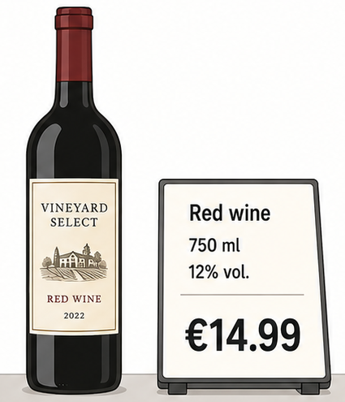
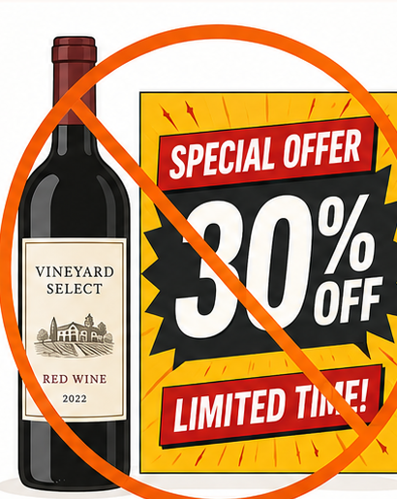
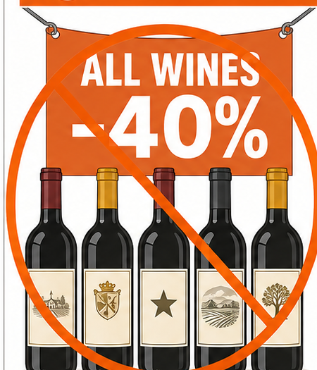
MINISTRY OF HEALTH OF LATVIA
MARKETING
Price and discount advertising
Price may be shown as neutral consumer information, but advertising discounts or category-wide promotions is prohibited.
✓
ALLOWED
⊘
PROHIBITED
⊘
PROHIBITED
Neutral price information
Price / discount advertising
Category-wide promotions
For one beverage unit only
No promotional price messaging
No “all wines -40%” type offers
NDPHS ASA EG 30 • Tallinn • 17 June 2026
07

Slide 8
MINISTRY OF HEALTH OF LATVIA
POLICY DEBATE
Industry response and emerging loopholes
Early implementation shows where the current framework still leaves room for alcohol visibility and indirect promotion.
1
Brand advertising
remains allowed
2
Hospitality sector
interpretations
3
Digital channels
create grey zones
Brand ads can still preserve recognition, visibility and appeal even when price-based promotion is restricted.
Some bars and restaurants read several new rules differently from retail trade; “happy hours” may therefore continue.
Websites, apps, social media and influencer-style content can blur the line between brand visibility and promotion.
Brand visibility
Hospitality
Digital
NDPHS ASA EG 30 • Tallinn • 17 June 2026
08

Slide 9
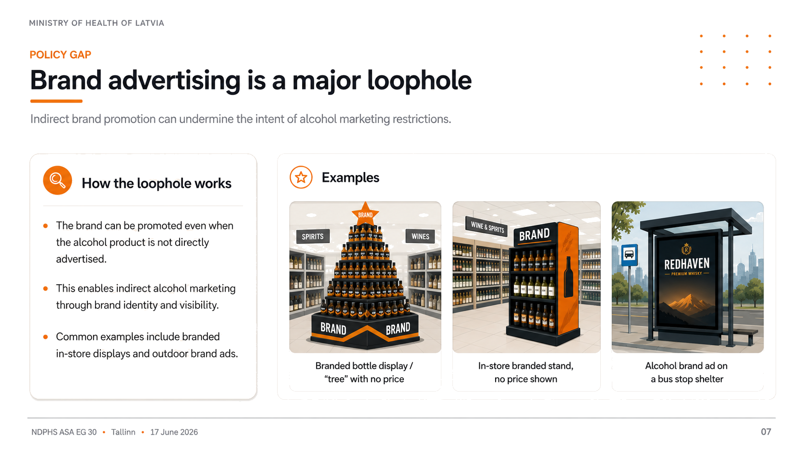
09

Slide 10



MINISTRY OF HEALTH OF LATVIA
POLICY GAP
Hospitality sector promotions continue despite no legal exception
What this looks like in practice
Examples
“Happy hour” and “1+1” alcohol offers continue to be advertised
‘.
Some venues offer a free alcoholic drink for arriving or entering.
Drink prices are promoted very visibly as a marketing message.
Happy hour / “1+1” offer
Free alcohol on arrival
Prominent drink price advertising
!
09
NDPHS ASA EG 30 • Tallinn • 17 June 2026
10

Slide 11
MINISTRY OF HEALTH OF LATVIA
POLICY DEBATE
Industry narratives
Common arguments used by the alcohol industry to challenge stricter regulation.
1
Narrative
2
Narrative
3
Narrative
Rural shops
are forced to close
People are switch
to surrogate alcohol,
such as cologne
Stricter rules
will fuel the illegal
alcohol market
NDPHS ASA EG 30 • Tallinn • 17 June 2026
10

Slide 12
MINISTRY OF HEALTH OF LATVIA
SECTION 02
Monitoring, evaluation and next steps
What can be responsibly monitored now — and why Latvia is not yet presenting impact claims.
02
NDPHS ASA EG 30 • Tallinn • 17 June 2026

Slide 13

MINISTRY OF HEALTH OF LATVIA
What exactly will be evaluated
Evaluation scope
Implementation and supervision
€
1
Whether the amendments were implemented in practice as intended by the legislator, and how supervision has functioned.
2
Availability environment and early indicators
Economic impact
Whether early changes can be observed in the alcohol availability environment and alcohol-related indicators.
assessment
3
Early public health signals
Whether initial signals of public health impact can be identified, including for sensitive groups such as minors.
Ministry of Economics +
Ministry of Finance
4
Context and data limitations
A complementary assessment of the amendments’ impact on the national economy.
Which external factors and data limitations affect interpretation of observed trends.
5
Future monitoring and improvements
What conclusions can be drawn for further monitoring and for improving the evaluation approach.
Health impact ≠ economic impact
Key principle: early findings should be interpreted together with implementation evidence, data limitations and wider economic context.
NDPHS ASA EG 30 · Tallinn · 17 June 2026
13

Slide 14
MINISTRY OF HEALTH OF LATVIA
Potential next legislative steps
Planned directions for the next package of alcohol policy restrictions
1. Minimum age to 20
Raise the minimum age for purchasing and consuming alcohol to 20, delaying initiation and reducing early risky drinking.
2. Full advertising ban
Cover brand advertising, sponsorship, digital marketing and other indirect promotion that maintain alcohol visibility and appeal.
1
2
3. Health warnings on packaging
Introduce mandatory warning and labelling requirements, including cancer risk, pregnancy, driving and other health-risk messages.
4. Minimum price / price policy
Assess minimum pricing or other price policy tools to limit access to very cheap alcohol, especially high-risk products.
3
4
5. Ban sales at petrol stations
Prohibit alcohol sales in fuel stations to align availability rules with traffic safety and public health objectives.
6. Sponsorship restrictions
Further restrict alcohol sponsorship in sport, culture and youth-related events to avoid links with healthy lifestyles and young audiences.
5
6
§
Policy direction: move from partial measures towards stronger controls on age, marketing, labelling, price and availability.
NDPHS ASA EG 30 · Tallinn · 17 June 2026
14

Slide 15
MINISTRY OF HEALTH OF LATVIA
LESSONS
Lessons learned from Latvia’s first implementation phase
1
Strong evidence helps, but political persistence is still needed.
2
Implementation is as important as adoption.
3
Marketing restrictions need clear interpretation and enforcement.
4
Early signals should be interpreted carefully.
5
Regional cooperation is valuable because challenges are similar.
NDPHS ASA EG 30 · Tallinn · 17 June 2026
12

Slide 16
MINISTRY OF HEALTH OF LATVIA
SECTION 03
Prevention, treatment and support
School-based prevention, integrated care for minors and accessible support services.
03
NDPHS ASA EG 30 • Tallinn • 17 June 2026

Slide 17
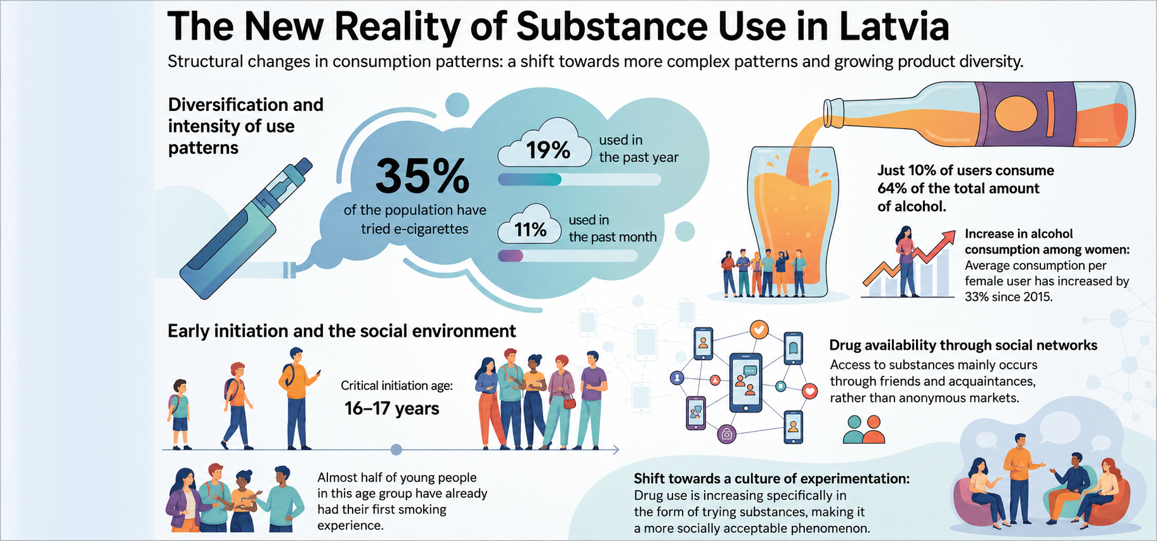
UNPUBLISHED DATA
16

Slide 18
MINISTRY OF HEALTH OF LATVIA
PILOT PROJECT
Why an integrated pathway was needed
Addiction care for minors had never been a strong policy priority; services were uneven and split across sectors.
Crisis trigger
National response
Access gaps
Fragmentation
2
3
4
A drug-use episode in Riga, including overdoses among minors, made the issue politically urgent.
The Prime Minister tasked the Ministry of Health to coordinate solutions at national level.
Specialised addiction services for minors were not consistently available across regions or service levels.
Responsibility was spread across health care, social services, municipalities, schools and child protection.
What followed
National working groups, a WHO mission and development of a clearer integrated care model.
NDPHS ASA EG 30 • Tallinn • 17 June 2026
17

Slide 19
MINISTRY OF HEALTH OF LATVIA
PILOT PROJECT
Pilot project for minors with substance abuse
The pilot is a state-funded pathway for minors with more severe substance-use problems.
1
Assessment and decision-making
2
Coordinated service route
3
Programme and legal changes
new assessment tool
multidisciplinary team
motivation programme reviewed and extended
algorithm for acute cases
transport to another treatment institution when needed
new performance criteria
clinical assessment within the first 72 hours
legal criteria for compulsory treatment clarified
clearer link to further treatment and support
Limitation
Because state funding is limited, the pilot mainly targets minors with more severe cases.
Next step
Work continues on linking mental health and addictions, including a new strategic framework.
NDPHS ASA EG 30 · Tallinn · 17 June 2026
18

Slide 20
MINISTRY OF HEALTH OF LATVIA
PREVENTION
“Unplugged” – addiction prevention programme
A school-based programme to delay or prevent initiation of substance use among pupils aged 12–14.
2021–2023
20 schools
12 structured lessons for pupils aged 12–14
Adapted and piloted in Latvia
Pilot phase in general education schools
2025
Nov 2025
Develops critical thinking, decision-making, communication, empathy and other social skills.
Materials updated, including e-cigarettes
First teacher training led by international trainer
Planned scale-up: at least 150 teachers across Latvia.
Methodological materials and implementation support are provided.
NDPHS ASA EG 30 · Tallinn · 17 June 2026
19

Slide 21
MINISTRY OF HEALTH OF LATVIA
PREVENTION ENVIRONMENT
Child well-being and prevention measures
Latvia is also expanding anti-bullying, behavioural support and school-environment measures.
○○
/\
Programme measures
⌂
School-environment measures (Ministry of Education)
KiVa
Education Law
Finnish anti-bullying programme, implemented in Latvia since 2023.
Indirectly reduces addiction risk through psychosocial factors.
From 1 September 2026, schools must implement systematic, age-appropriate programmes to prevent violence and bullying and to promote well-being.
This supports a more consistent prevention approach in schools.
STOP 4–7
Early behavioural intervention for children with behavioural problems.
Focuses on impulsivity and aggression; planned for broader implementation.
Mobile phone restrictions
Ban in preschool and grades 1–6 from 1 September 2025; extended to grade 9 from 1 June 2026.
Together, these measures show a move from fragmented initiatives towards a broader prevention and child well-being environment.
NDPHS ASA EG 30 · Tallinn · 17 June 2026
20

