Slide 1
ADVANCING ALCOHOL POLICY
Updates from Movendi International

Slide 2

CONVERSATION TOPICS
Alcohol policy (progress)
OECD report: costs to society!
“No Safe Level” fight
Alcohol industry in decline
People’s support
And yes it works: Best Buys world maps

Slide 3

ALCOHOL POLICY ADVOCACY SUPPORT
50+
COUNTRIES
Notes:
In 2023 Movendi International supported alcohol policy advocacy in more than 30 countries and jurisdictions – these insights, expertise, and experiences we also like to contribute to achieve alcohol policy progress in Kenya

Slide 4
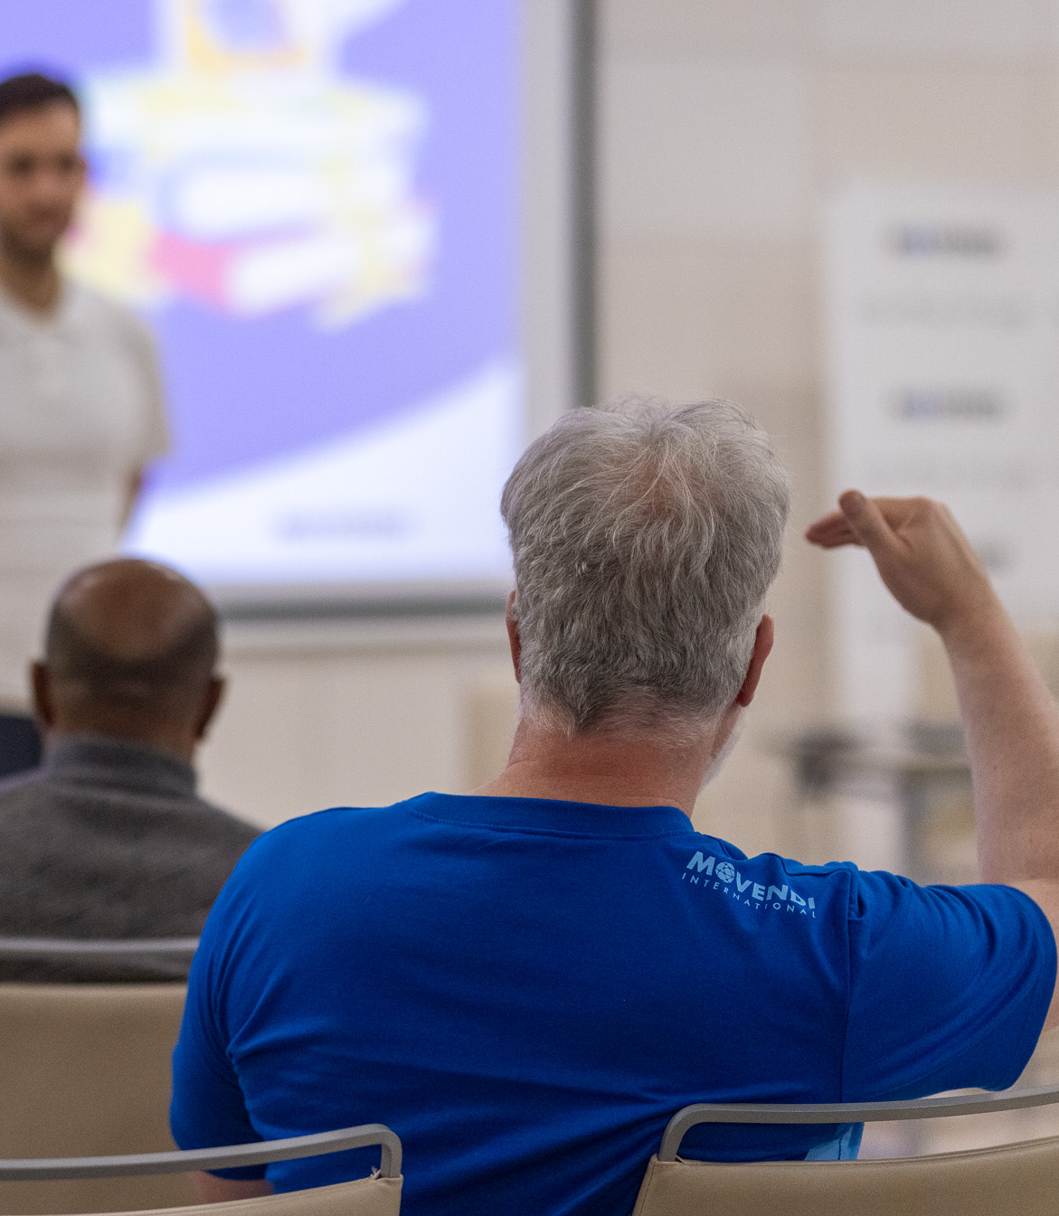
ELEMENTS OF SUCCESS
Lead with values/ common concerns
  What matters to people
  What do people understand/ hear/ feel
  How can we frame our topic, problem, solution
Social norming
  People care and people are concerned (social license)
  People want change: Public support for action (social proof)
Need for action
  True extent of harm
  Cost of inaction
Action matters
  Explain why we have problems
  Point to alcohol industry activity that caused problems
We can have nice things
  Solutions work
  Solutions benefit everyone

Slide 5
CONVERSATION TOPICS
Alcohol policy (progress)
OECD report: costs to society!
  Unique advocacy tool
“No Safe Level” fight
Alcohol industry in decline
People’s support
And yes it works: Best Buys world maps

Slide 6

OECD REPORT
HIGHLIGHTS
ALCOHOL POLICY
The report at a glance
OECD flagship study
51 countries, projections to 2050
Models six modifiable NCD risk factors, including “harmful alcohol use”
Benchmarks every country against the best‑performing 25% of peers ("Top Quartile")

Slide 7
NEW OECD REPORT HIGHLIGHTS POTENTIAL OF ALCOHOL POLICY
Alcohol: a top‑tier NCD risk factor
Named alongside smoking, unhealthy diet and physical inactivity as a primary modifiable risk
Linked to cancer, CVD, COPD, diabetes, dementia, alcohol use disorders and mental ill‑health
Men bear the brunt: OECD male premature NCD mortality 77% higher than female

Slide 8
NEW OECD REPORT HIGHLIGHTS POTENTIAL OF ALCOHOL POLICY
What aligning alcohol use with the best peers would deliver (per year, OECD)
65,000 premature deaths avoided
115,000 new NCD cases prevented
USD PPP 25 billion saved in health spending
1.28 million full‑time workers of output recovered
GDP up 0.3%

Slide 9
NEW OECD REPORT HIGHLIGHTS POTENTIAL OF ALCOHOL POLICY
Societal co‑benefits
5,367 road traffic deaths prevented each year in the OECD (2,113 in the EU)
2,358 homicides prevented each year in the OECD (327 in the EU)
5% of road deaths and 5% of homicides avoidable through alcohol policy alone

Slide 10
NEW OECD REPORT HIGHLIGHTS POTENTIAL OF ALCOHOL POLICY
Alcohol punches above its weight on the economy
#2 priority for workforce output and GDP across both the OECD and the EU – ahead of smoking
#1 mortality priority in Austria, Germany and Slovenia
#1 GDP priority in Austria, Denmark, France, Germany, Luxembourg, Slovenia, Sweden, Switzerland

Slide 11
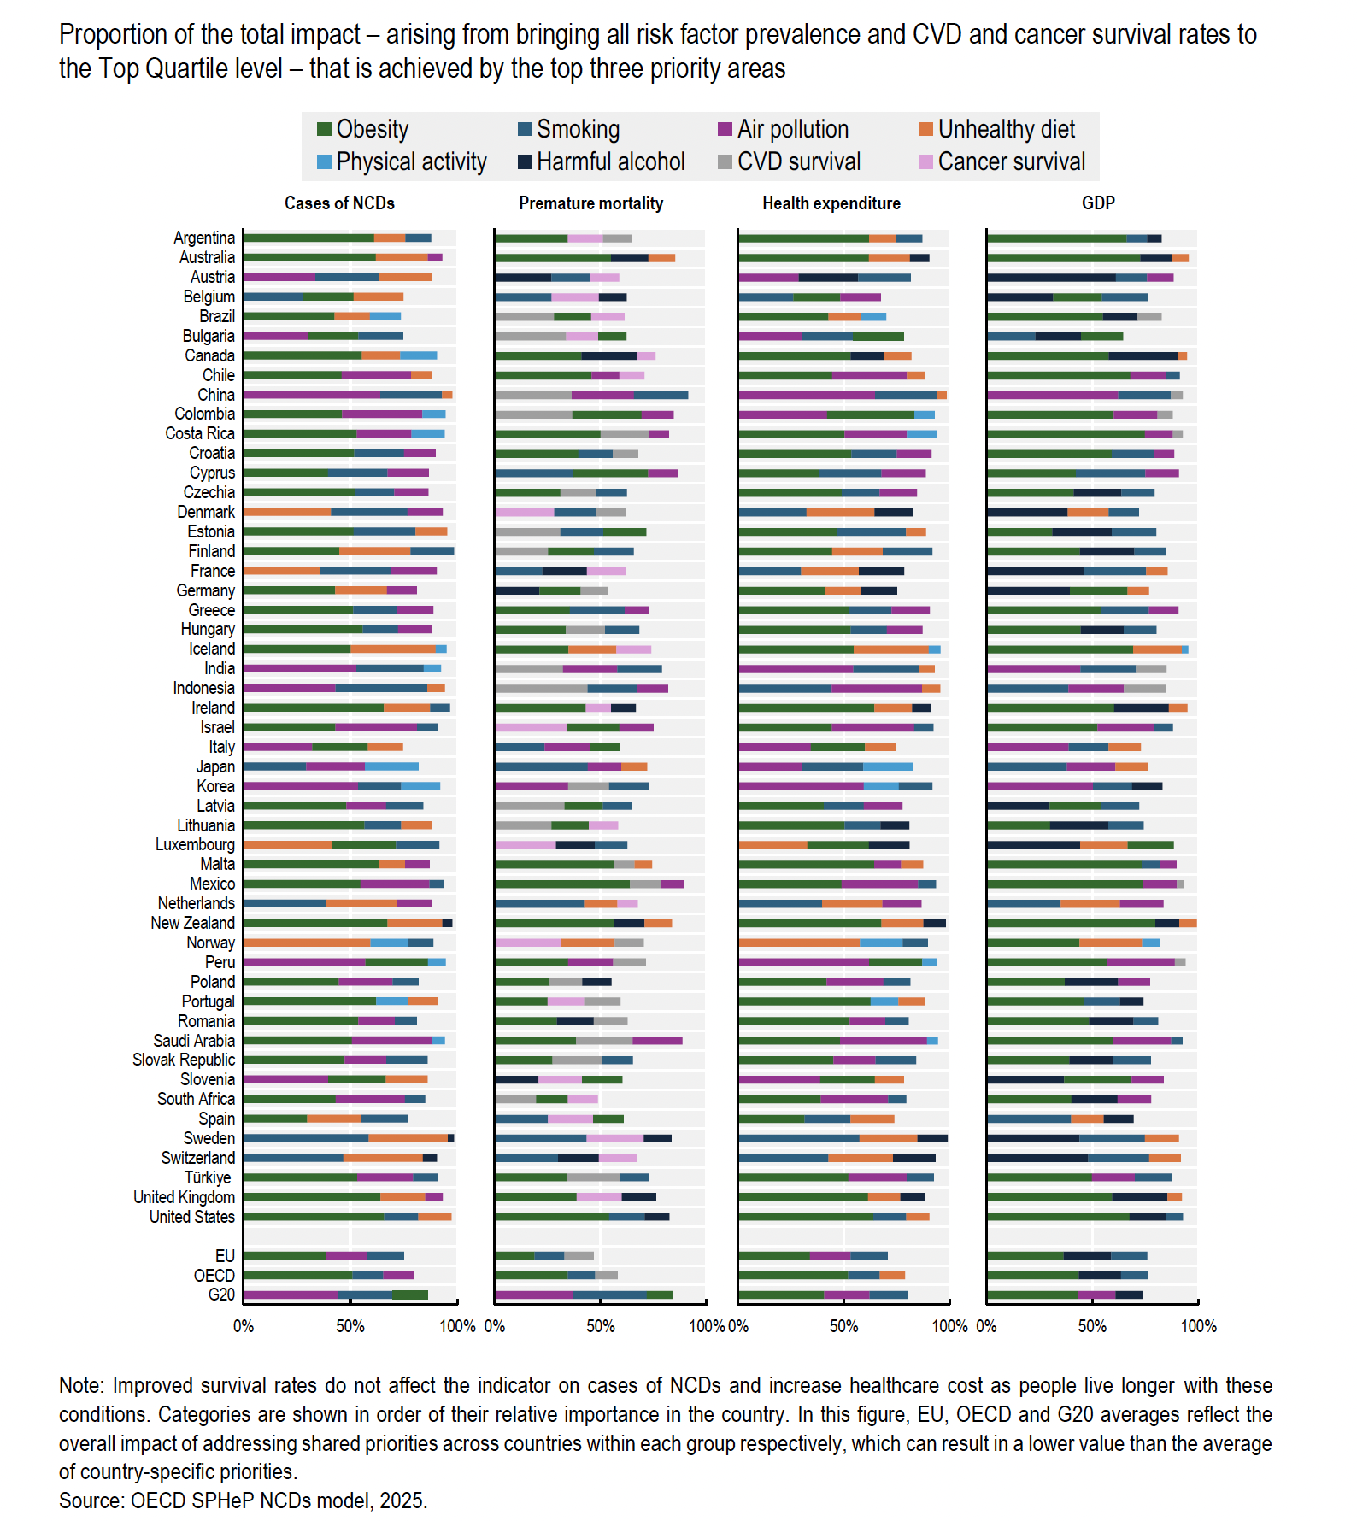
Alcohol punches above its weight on the economy
#2 priority for workforce output and GDP across both the OECD and the EU — ahead of smoking
#1 mortality priority in Austria, Germany and Slovenia
#1 GDP priority in Austria, Denmark, France, Germany, Luxembourg, Slovenia, Sweden, Switzerland

Slide 12
NEW OECD REPORT HIGHLIGHTS POTENTIAL OF ALCOHOL POLICY
OECD endorses alcohol policy
Minimum unit pricing to tackle cheap alcohol
Ban on marketing to children and regulation of alcohol advertising
Brief counselling in primary care: over USD 4 returned for every USD 1 invested
Comprehensive, multi‑pronged packages deliver the highest impact

Slide 13
NEW OECD REPORT HIGHLIGHTS POTENTIAL OF ALCOHOL POLICY
Implementation gap in primary care
Only about one in four daily or near‑daily alcohol users aged 45+ gets any alcohol counselling from their primary care provider
Lowest counselling coverage of any lifestyle area measured
Concrete, measurable failure governments can fix now

Slide 14
NEW OECD REPORT HIGHLIGHTS POTENTIAL OF ALCOHOL POLICY
Progress is real but fragile
OECD consumption down to 8.7 litres per person;
EU at 10.1 litres
But population ageing and rising obesity erase alcohol‑related gains
Without stronger action, NCD spending per capita will rise more than 50% by 2050

Slide 15
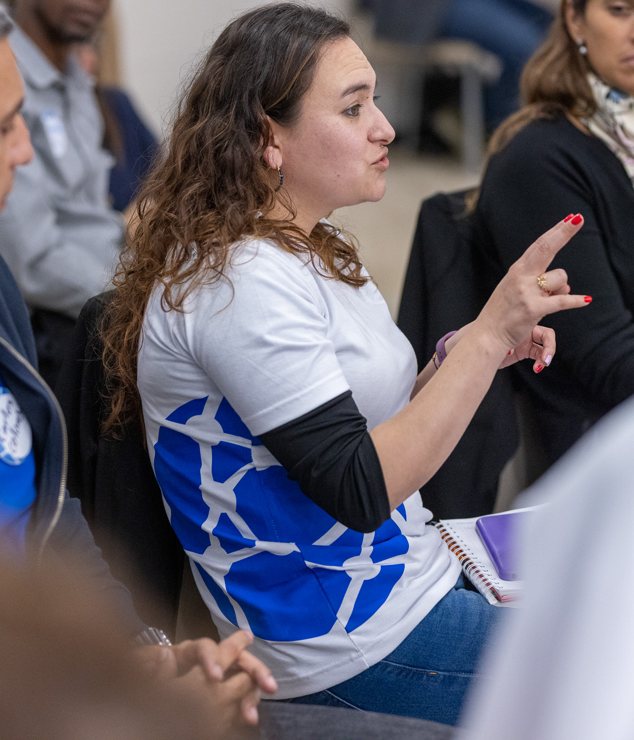
ECONOMICS OF ALCOHOL
Reality
2/3 of alcohol harm outside healthcare
2.6% of GDP loss
Productivity losses
  Absenteeism
  Presenteeism
  Crowding out & crowding in
Propaganda
Big Alcohol claims economic “contribution”
Resource: “COUNTERING ALCOHOL INDUSTRY OPPOSITION TO ALCOHOL TAXES. A Guide for Advocates”

Slide 16
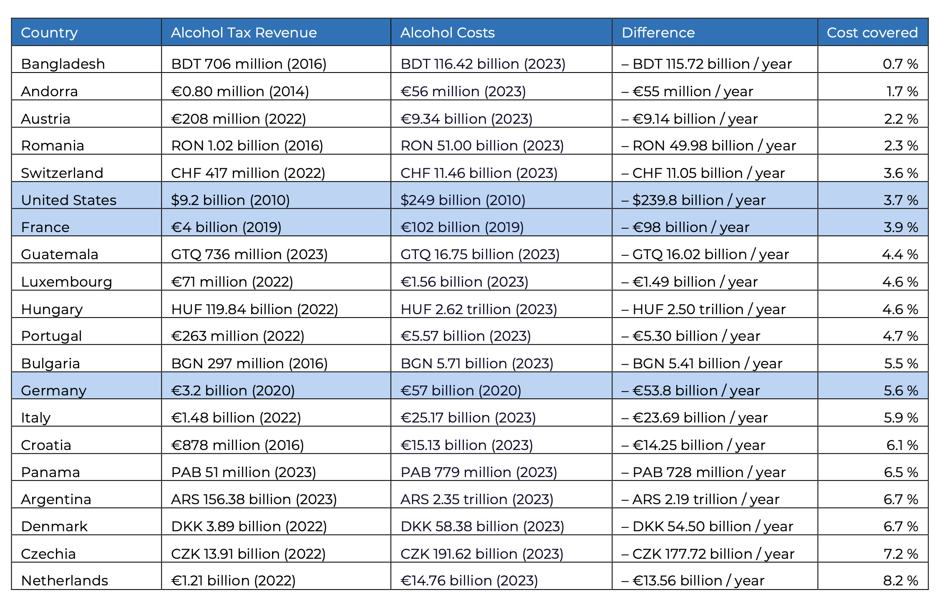
Notes:
Present the data in two ways – a long table showing the alcohol tax revenue and the alcohol costs
Blue background are countries with previously published data on alcohol costs
We show the difference and a new measurement on part of alcohol costs covered by alcohol taxes

Slide 17
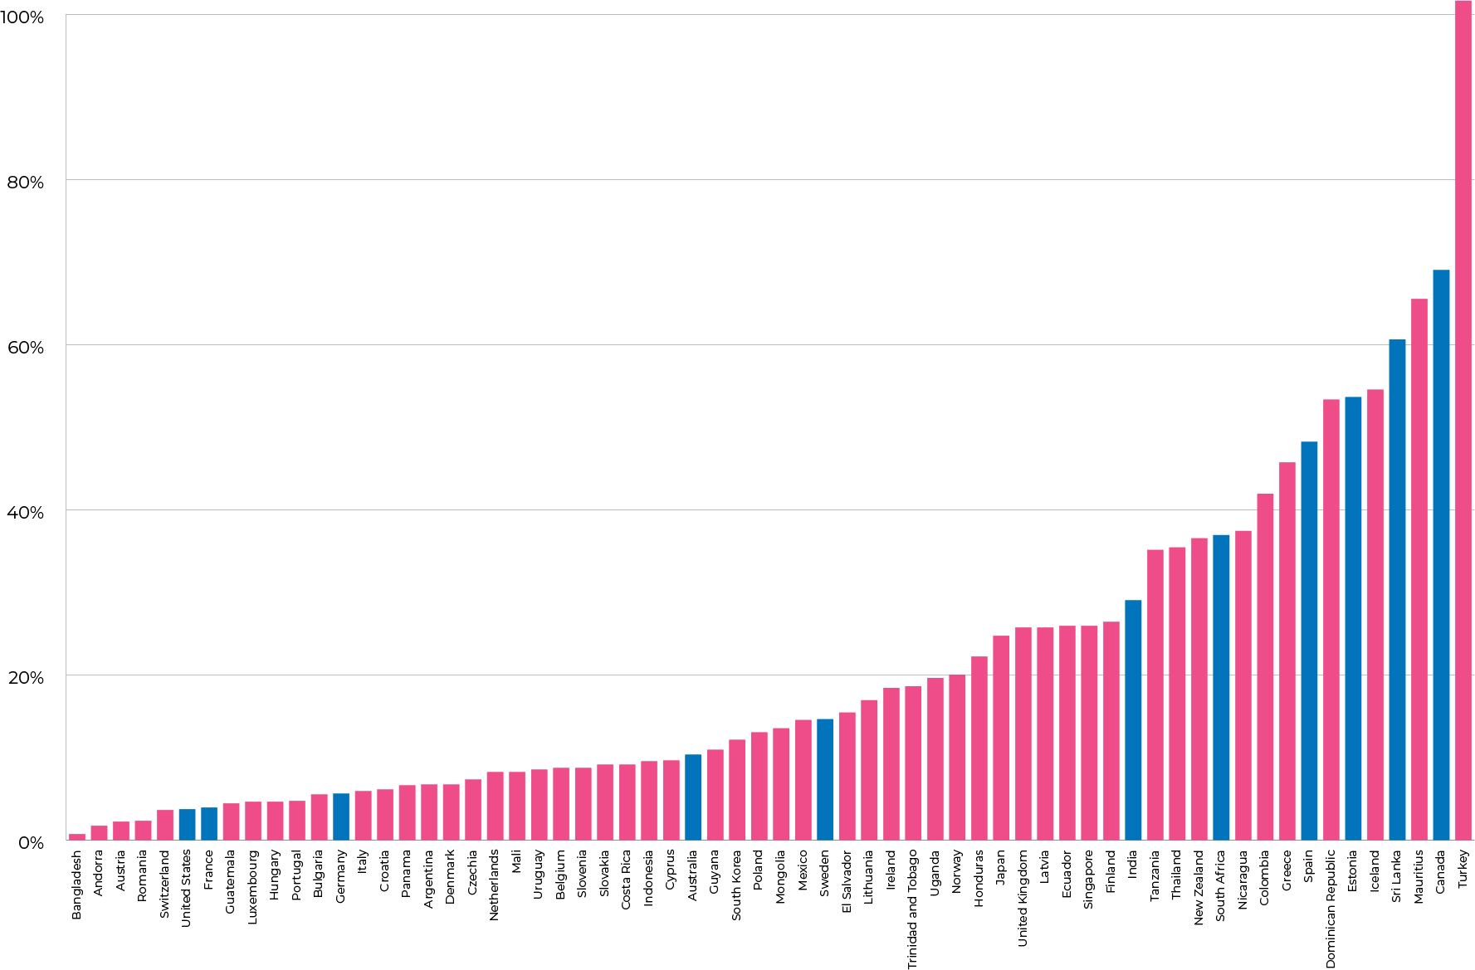
Notes:
And we have a graph ranking the countries based on coverage
Turkey really is an outlier.

Slide 18

RESULTS: WHAT THE DATA SHOWS
Only six countries exceed 50% coverage
Türkiye is the sole revenue-above-cost case at 101.6% (low alcohol use)
High-income Europe clusters at the bottom: Austria 2.2%, France 3.9%, Germany 5.6%, Denmark 6.7%
The driver is policy inaction, not administrative capacity

Slide 19
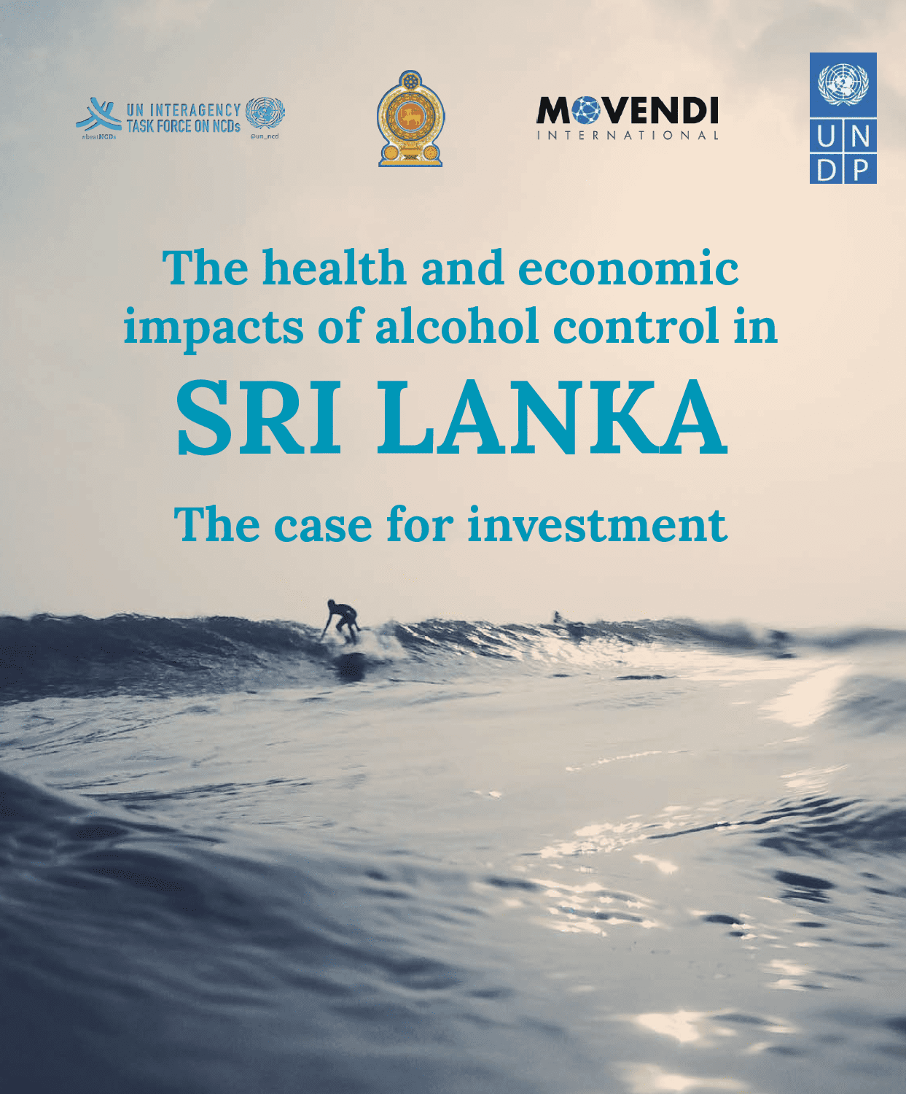
ALCOHOL AS OBSTACLE
TO HEALTH &
DEVELOPMENT
Alcohol harms in Sri Lanka
20,000+ deaths per year from alcohol harm
Alcohol drives poverty, domestic violence
Lost economic growth and productivity: 2% of GDP

Slide 20

SRI LANKA INVESTMENT CASE RESULTS
ROI of 12.2:1
104,000 deaths prevented over 10 years
LKR 643 billion (approx. USD 2 billion) in economic costs averted
Revenue generated
Results are conservative
Sri Lanka raised alcohol taxes!
  Revenue up
  Population-level consumption down
  Harm and costs down

Slide 21
CONVERSATION TOPICS
Alcohol policy (progress)
OECD report: costs to society!
“No Safe Level” fight
  Industry tools
  Public health tools and relevance
Alcohol industry in decline
People’s support
And yes it works: Best Buys world maps

Slide 22

THE ‘NO SAFE LEVEL’ FIGHT
Concerted alcohol industry attack on “no safe level” fact
  CSSA guidelines
  WHO Statement (Lancet)
  U.S. Dietary Guidelines (U.S. Congress)
  CODEX
  Swiss parliament
Countries, regions improve guidelines
  LAC Cancer Code
  Mexican Dietary Guidelines
  Nordic Nutrition Recommendations
  Mediterranean Diet Guidelines 2025

Slide 23
THE ‘NO SAFE LEVEL’ FIGHT
Big Alcohol Tools
Personal attacks (attempts at discrediting)
National Academies of Sciences, Engineering and Medicine (NASEM) review – commissioned after aggressive alcohol industry lobbying
Burrying of scientifically sound Alcohol Intake and Health Study
  Commissioned by health authorities, free from conflicts of interest, warning that even one alcoholic drink per day increases cancer risk, was sidelined and burried
UNATI study
  Acronym is deliberately built around the phrase: “To drink or Not To drink?”

Slide 24
THE ‘NO SAFE LEVEL’ FIGHT
Big Alcohol Tools:UNATI study
Acronym derived from the study’s title
Principal investigator, Miguel Ángel Martínez-González, described project as randomized trial intended to address long-running question of whether moderate alcohol use, esp. wine consumed within a Mediterranean lifestyle pattern, is preferable to alcohol abstention

Slide 25
THE ‘NO SAFE LEVEL’ FIGHT
UNATI Trial: What Policymakers Need to Know
A Large Alcohol Trial With Major Limitations
What UNATI Does:
  European Research Council-funded trial of 10,000+ alcohol users aged 50–75
  Compares advice to abstain versus advice to continue moderate alcohol use
  Focuses primarily on wine consumption within a Mediterranean lifestyle context
  Designed as a non-inferiority trial: aims to show that moderate alcohol use is “not worse” than abstention

Slide 26
THE ‘NO SAFE LEVEL’ FIGHT
UNATI Trial: What Policymakers Need to Know
Study raises serious concerns in three domains:
  Structural design limitations that bias toward “non-inferiority.”
  Biased participant selection and limited public health relevance.
  Documented conflicts of interest and institutional embedding within industry-linked research ecosystems

Slide 27
THE ‘NO SAFE LEVEL’ FIGHT
UNATI Trial: Concise Summary for Journalists
Publicly funded, but several investigators have declared ties to wine- and beer-linked organizations
Design makes it statistically easier to conclude alcohol is “not worse” than abstention
Short time frame cannot detect major alcohol-related harms (cancer)
Studies older, resilient alcohol users, not general population
Industry-aligned platforms have already amplified study to promote wine-health narrative
Key concerns: governance risk, structural bias, and policy misinterpretation

Slide 28

WHEN SCIENCE PREVAILS
Updated Mediterranean Diet Guidelines
Published in 2025, explicitly exclude alcohol, including wine, from their core recommendations
Authors cited growing evidence that already low-dose alcohol use increases cancer and cardiovascular risk and highlighted methodological limitations in earlier studies that appeared to show protective effects

Slide 29

NEW STUDY CHALLENGES CLAIMS THAT WINE HAS HEALTH BENEFITS
Published in European Heart Journal (2026)
Editorial by Tim Stockwell and Jinhui Zhao of the Canadian Institute for Substance Use Research
Identifies three methodological flaws in a new study claiming daily wine consumption reduces cardiovascular and all-cause mortality risk among people following a Mediterranean diet

Slide 30
NEW STUDY CHALLENGES CLAIMS THAT WINE HAS HEALTH BENEFITS
Flaw 1: Biased comparison group
Wine consumers are systematically healthier than non-consumers for reasons unrelated to alcohol, such as higher income and better healthcare access, which inflates apparent benefits

Slide 31
NEW STUDY CHALLENGES CLAIMS THAT WINE HAS HEALTH BENEFITS
Flaw 2 The "sick quitter" effect:
People who quit or reduce alcohol use tend to have poor health profiles, meaning the abstainer reference group is biased toward ill health
Makes alcohol consumers appear healthier by comparison

Slide 32
NEW STUDY CHALLENGES CLAIMS THAT WINE HAS HEALTH BENEFITS
Flaw 3 Age bias
Apparent protective effects of low-volume alcohol use are more likely to appear in older cohorts, where the abstainer group increasingly fills with people who stopped consuming alcohol due to illness and frailty

Slide 33
NEW STUDY CHALLENGES CLAIMS THAT WINE HAS HEALTH BENEFITS
When Bias Is Removed, the Apparent Benefits Disappear
When a reference group of very light consumers (rather than abstainers) is used, the apparent mortality benefit of moderate alcohol consumption becomes non-significant
In the younger SUN cohort – less susceptible to lifetime selection bias – moderate alcohol consumers showed a significant 50% increase in all-cause mortality risk compared to very light consumers

Slide 34
NEW STUDY CHALLENGES CLAIMS THAT WINE HAS HEALTH BENEFITS
When Bias Is Removed, the Apparent Benefits Disappear
No pooled wine vs non-wine comparison across the full sample showed significant differences in mortality risk
Apparent health benefits linked with low-volume alcohol use can be generated or contradicted entirely depending on methodological choices — particularly the choice of reference group and cohort age
Source: Stockwell T, Zhao J. European Heart Journal (2026). https://doi.org/10.1093/eurheartj/ehag253

Slide 35

HOW KNOWLEDGE OF ALCOHOL HARMS RELATES TO POLICY SUPPORT
“Support for alcohol policies and its association with knowledge of alcohol-related health consequences: findings from 5 EU countries”
Journal article
European Journal of Public Health
Feb. 19, 2026
Daša Kokole , Maria Neufeld , Aleksandra Olsen , Carina Ferreira-Borges , Catherine Paradis , Jürgen Rehm , Daniela Correia

Slide 36
HOW KNOWLEDGE OF ALCOHOL HARMS RELATES TO POLICY SUPPORT
Understanding how knowledge of alcohol harms relates to policy support can inform strategies to increase acceptance of alcohol policies
Study examines relationship between the two across five EU countries
Online survey measuring knowledge of alcohol-related health consequences and alcohol policy support was conducted in October-November 2024 (N = 3620)

Slide 37
HOW KNOWLEDGE OF ALCOHOL HARMS RELATES TO POLICY SUPPORT
Support for alcohol policy measures was largely consistent across countries and was lowest for increasing alcohol price and highest for implementing alcohol impaired driving counter-measures
Factor analysis of 15 policy items showed four factors:
  Supportive and Educational interventions,
  Marketing and Youth Protection policies,
  Point of Sale and Display Regulation policies and
  Pricing and Physical Availability control policies

Slide 38
HOW KNOWLEDGE OF ALCOHOL HARMS RELATES TO POLICY SUPPORT
After adjusting for sociodemographic characteristics and alcohol consumption patterns, knowledge of alcohol causing cancer was positively associated with support for
  Point of Sale and Display Regulation, and
  Pricing and Physical Availability policies

Slide 39
HOW KNOWLEDGE OF ALCOHOL HARMS RELATES TO POLICY SUPPORT
Belief that wine benefits heart health was negatively associated with support for
  Marketing and Youth Protection policies, and
  Pricing and Physical Availability policies

Slide 40
HOW KNOWLEDGE OF ALCOHOL HARMS RELATES TO POLICY SUPPORT
Study replicates previous findings demonstrating the link between cancer knowledge and support for population-level alcohol policies in European context
Interventions aimed at increasing this knowledge should be considered a critical foundation for effective alcohol policy efforts, as informed publics are more likely to support and engage with population-level measures

Slide 41
CONVERSATION TOPICS
Alcohol policy (progress)
OECD report: costs to society!
“No Safe Level” fight
Alcohol industry in decline
People’s support
And yes it works: Best Buys world maps

Slide 42
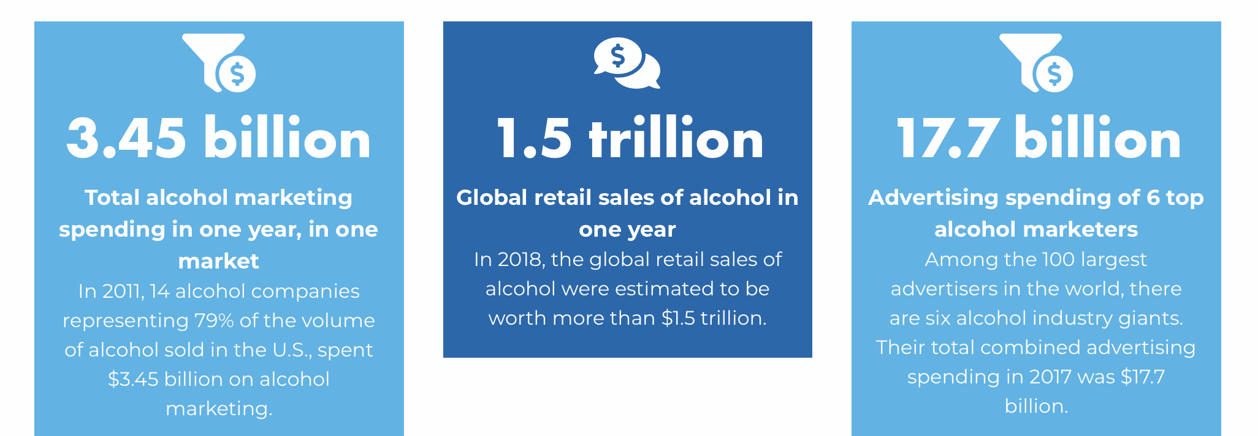
SETTING THE SCENE

Slide 43
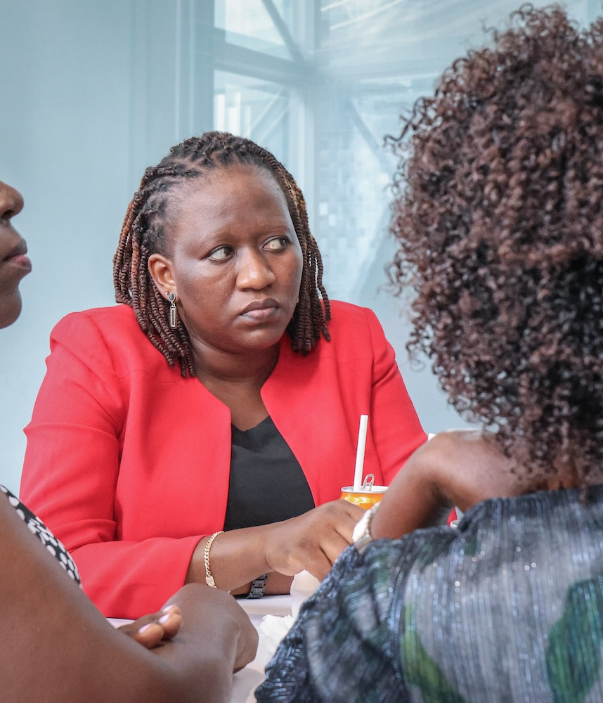
ALCOHOL MARKETING
German Bundesliga
Nairobi Marathon
Cricket championships
Olympic Games

Slide 44
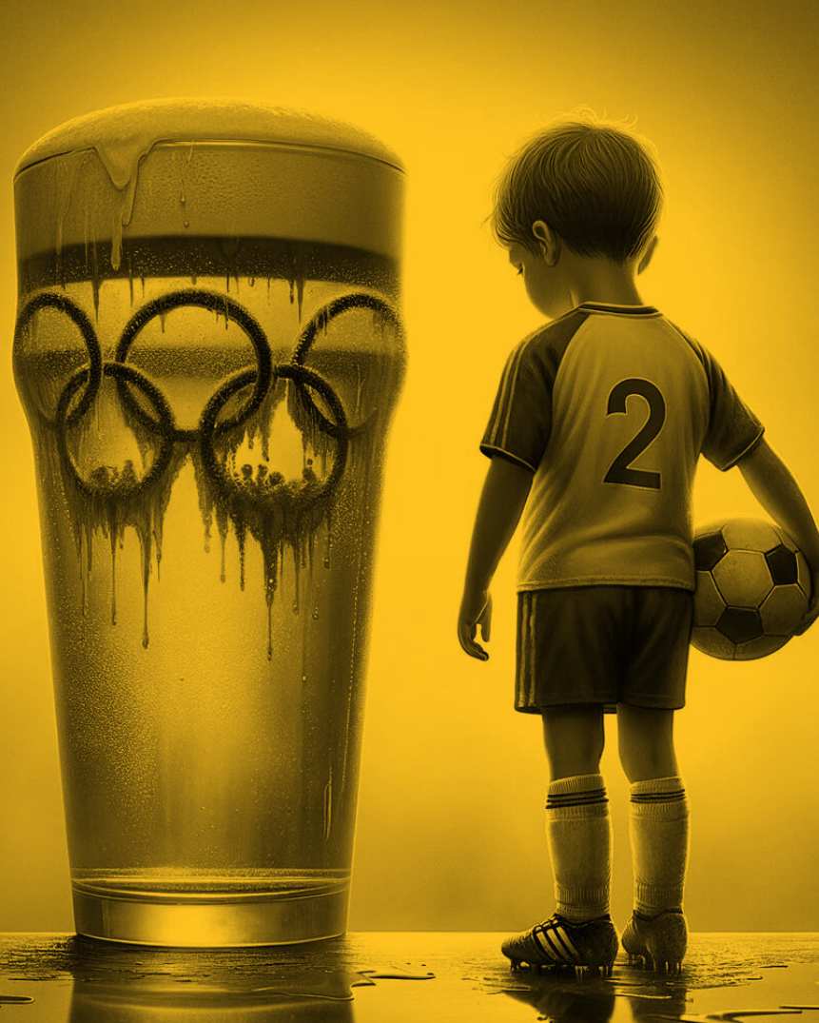
HIJACKING SPORTS: NORMALIZING ALCOHOL USE THROUGH SPORTS SPONSORSHIP
2024 Olympics: AB InBev broke precedent by sponsoring the Olympic Games, undermining the health-focused ethos of elite sports
Premier League: Heineken Uganda deployed beer tanker trucks at games in a country where 50% of the population is under 18
Formula 1: Heineken sponsorship, driving games etc

Slide 45

DIGITAL PREDATORS:
TARGETING YOUTH WITH
HIGH-TECH MARKETING
Diageo's partnership with Netflix's "Squid Game”
Alcohol advertising during Lego Masters in Australia
Collecting and using personal data for marketing, using AI

Slide 46
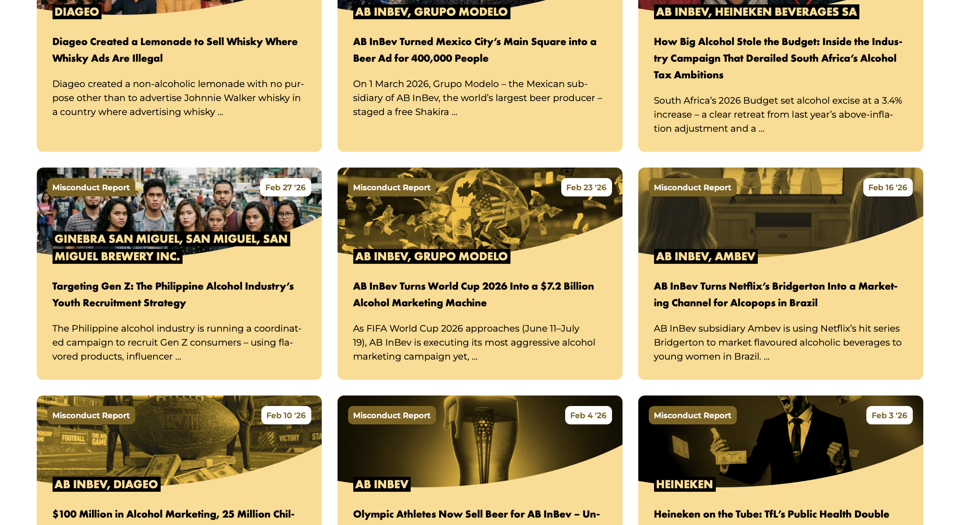

Slide 47
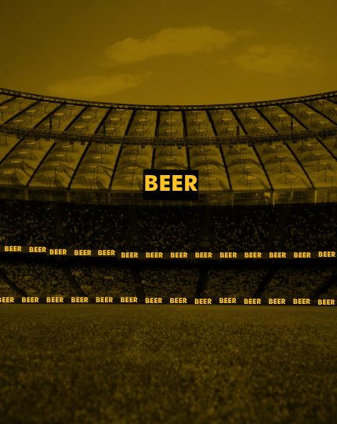
BIG ALCOHOL AND THE FOOTBALL WORLD CUP
Big Alcohol Turns 2026 FIFA World Cup into Largest Alcohol Marketing Operation in Sporting History
Alcohol corporations Diageo, AB InBev and Ambev are using 2026 FIFA World Cup as central lever to reverse structural decline in alcohol use among young people
Generation Z is using less alcohol than previous generations across many countries
  US per capita alcohol consumption is at its lowest level since 1995

Slide 48
BIG ALCOHOL AND THE FOOTBALL WORLD CUP
Big Alcohol Turns 2026 FIFA World Cup into Largest Alcohol Marketing Operation in Sporting History
AB InBev's global alcohol marketing operation around tournament is valued at $7.2 billion, with estimated $250 million per year going to sports sponsorships alone
Diageo has become Official Spirits Supporter of the FIFA World Cup 2026 across North, Central and South America
  First time the liquor giant has partnered with the tournament
  Putting Casamigos, Don Julio, Buchanan's, Johnnie Walker and Smirnoff in front of billions of football fans, including children and young people, across more than 20 countries

Slide 49
BIG ALCOHOL AND THE FOOTBALL WORLD CUP
Strategy Is Already Delivering Financial Results
Diageo reported a 9.4% sales decline in North America and a 15.4% drop in spirits volumes
  but offset these losses through a 16.2% sales increase in Latin America driven by distributors stocking up ahead of the World Cup

Slide 50
BIG ALCOHOL AND THE FOOTBALL WORLD CUP
Strategy Is Already Delivering Financial Results
Ambev built 5 branded arenas across Brazilian cities to host public screenings alongside live music and alcohol promotion, drawing an expected 600,000 in-person visitors, with national broadcast coverage reaching a far wider audience
Ambev's Q1 2026 Brazil beer volumes reached an all-time first-quarter high; the company's share price jumped 15.3% in a single day
  largest single-day rise since 1999
Every recent World Cup has produced measurable alcohol sales spikes: AB InBev's sales rose by 140 million litres during Brazil 2014, and Budweiser revenue jumped 10.1% outside the US during the 2018 tournament

Slide 51
BIG ALCOHOL AND THE FOOTBALL WORLD CUP
"Responsible Consumption" Framing Contradicts the Financial Logic
Almost every World Cup alcohol campaign is publicly framed as "responsible consumption”
But financial reporting tells a different story:
  Tournament is explicitly described by alcohol company CFOs as engine for inventory build-ups and sales recovery
  Zero-alcohol products are used to anchor “responsibility” narrative but they hold only around 2% of the global beer market;
  Remaining 98% is what World Cup marketing is built to sell

Slide 52
BIG ALCOHOL AND THE FOOTBALL WORLD CUP
"Responsible Consumption" Framing Contradicts the Financial Logic
Research is consistent: repeated exposure to alcohol marketing through sport increases alcohol use among children and young people, normalises alcohol in social and family settings, and creates positive associations with alcohol that operate below conscious awareness
2018 FIFA World Cup alone delivered 3.3 billion alcohol brand impressions in UK, including an estimated 385 million impressions to children
2026 tournament spans 16 cities and 104 matches, with an expected 6.5 million in-stadium spectators and global broadcast audiences in the billions, including children and young people

Slide 53
BIG ALCOHOL AND THE FOOTBALL WORLD CUP
Norway: Erling Haaland Recruited as Budweiser Ambassador
World Cup sponsor Budweiser signed Erling Haaland as ambassador for its "Let It Pour" campaign, launched in 40 countries ahead of the tournament
Campaign is not running in Norway, where alcohol advertising is illegal — but the ad features a player in what closely resembles the Norwegian national team jersey, number 9, without showing the face, visibly exploiting Haaland's status as Norway's most prominent international footballer

Slide 54
BIG ALCOHOL AND THE FOOTBALL WORLD CUP
Norway: Erling Haaland Recruited as Budweiser Ambassador
Inger Lise Hansen, Secretary General of Actis described the move as cynical
Hanne Cecilie Widnes, Secretary General of IOGT Norway, called it tragic: "He is a great hero for many young people in many countries. The Norwegian Football Federation should have put a stop to this"
The Norwegian Football Federation confirmed it was informed of the deal but stated it cannot prevent a player from participating in a global marketing campaign for a FIFA World Cup sponsor

Slide 55
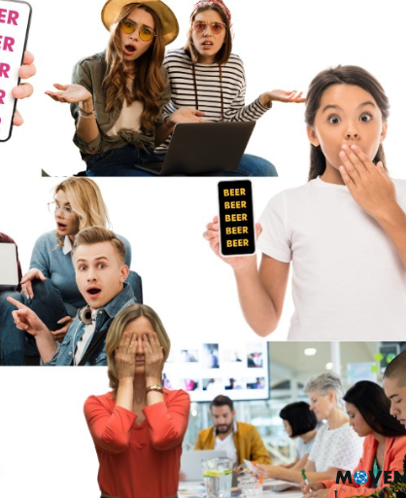
MOVENDI LAUNCHES CAMPAIGN TO DOCUMENT ALCOHOL ADS DURING WORLD CUP
FIFA World Cup starts in two weeks
Together with members from Kenya, Latvia, Mongolia, Sri Lanka, and Zimbabwe developed a collective initiative

Slide 56
MOVENDI LAUNCHES CAMPAIGN TO DOCUMENT ALCOHOL ADS DURING WORLD CUP
Global campaign to document and expose alcohol marketing during the tournament
With 1.7 billion children among the estimated 6 billion viewers, and alcohol companies openly treating the World Cup as a sales opportunity, the stakes for children’s health and rights could not be clearer

Slide 57
CONVERSATION TOPICS
Alcohol policy (progress)
OECD report: costs to society!
“No Safe Level” fight
Alcohol industry in decline
People’s support
And yes it works: Best Buys world maps

Slide 58

PEOPLE WANT ACTION: PUBLIC SUPPORT FOR ALCOHOL POLICY

Slide 59
SUPPORT FOR ALCOHOL TAX INCREASE

Slide 60
CONVERSATION TOPICS
Alcohol policy (progress)
OECD report: costs to society!
“No Safe Level” fight
Alcohol industry in decline
People’s support
And yes it works: Best Buys world maps

Slide 61
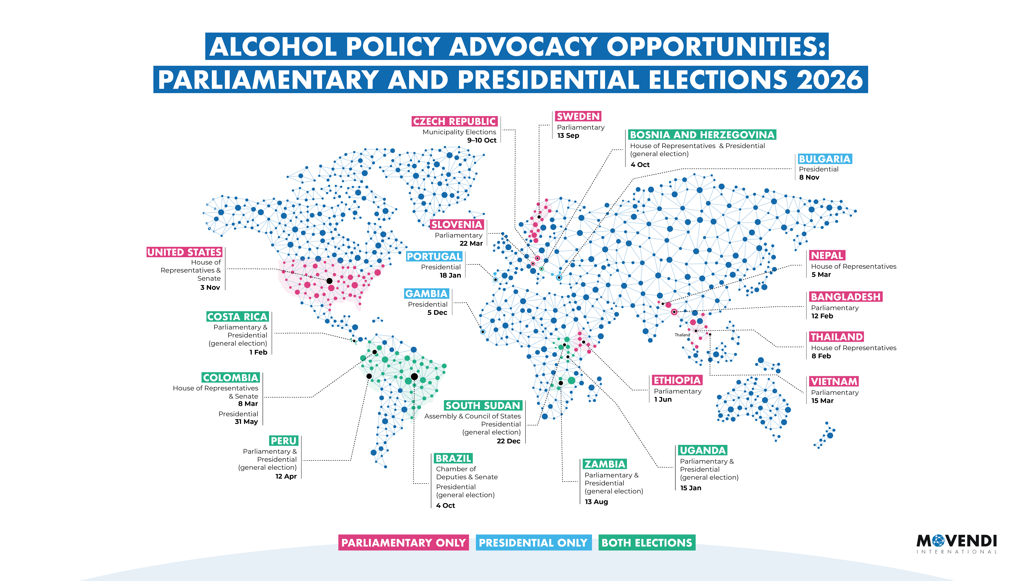

Slide 62
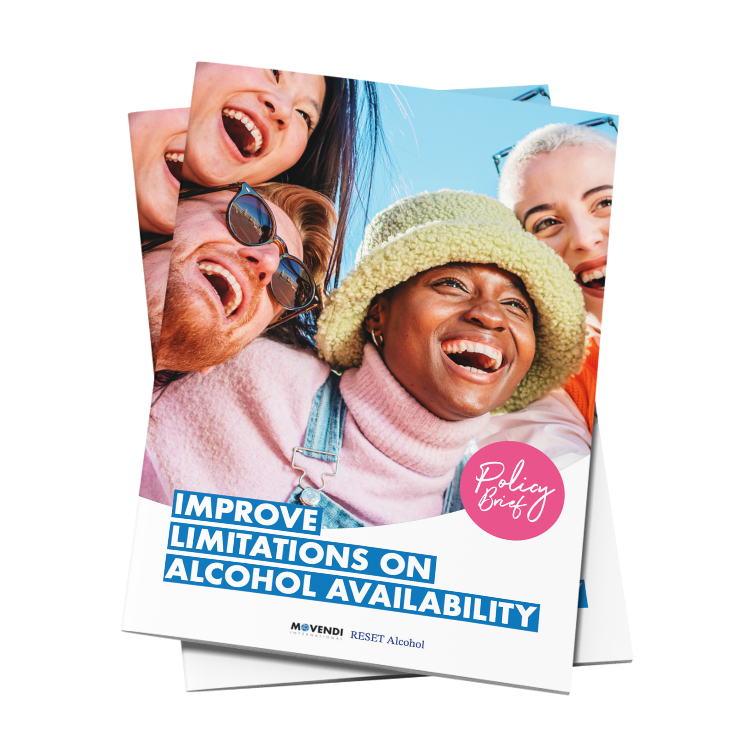
BRAND NEW
POLICY
BRIEFS

Slide 63
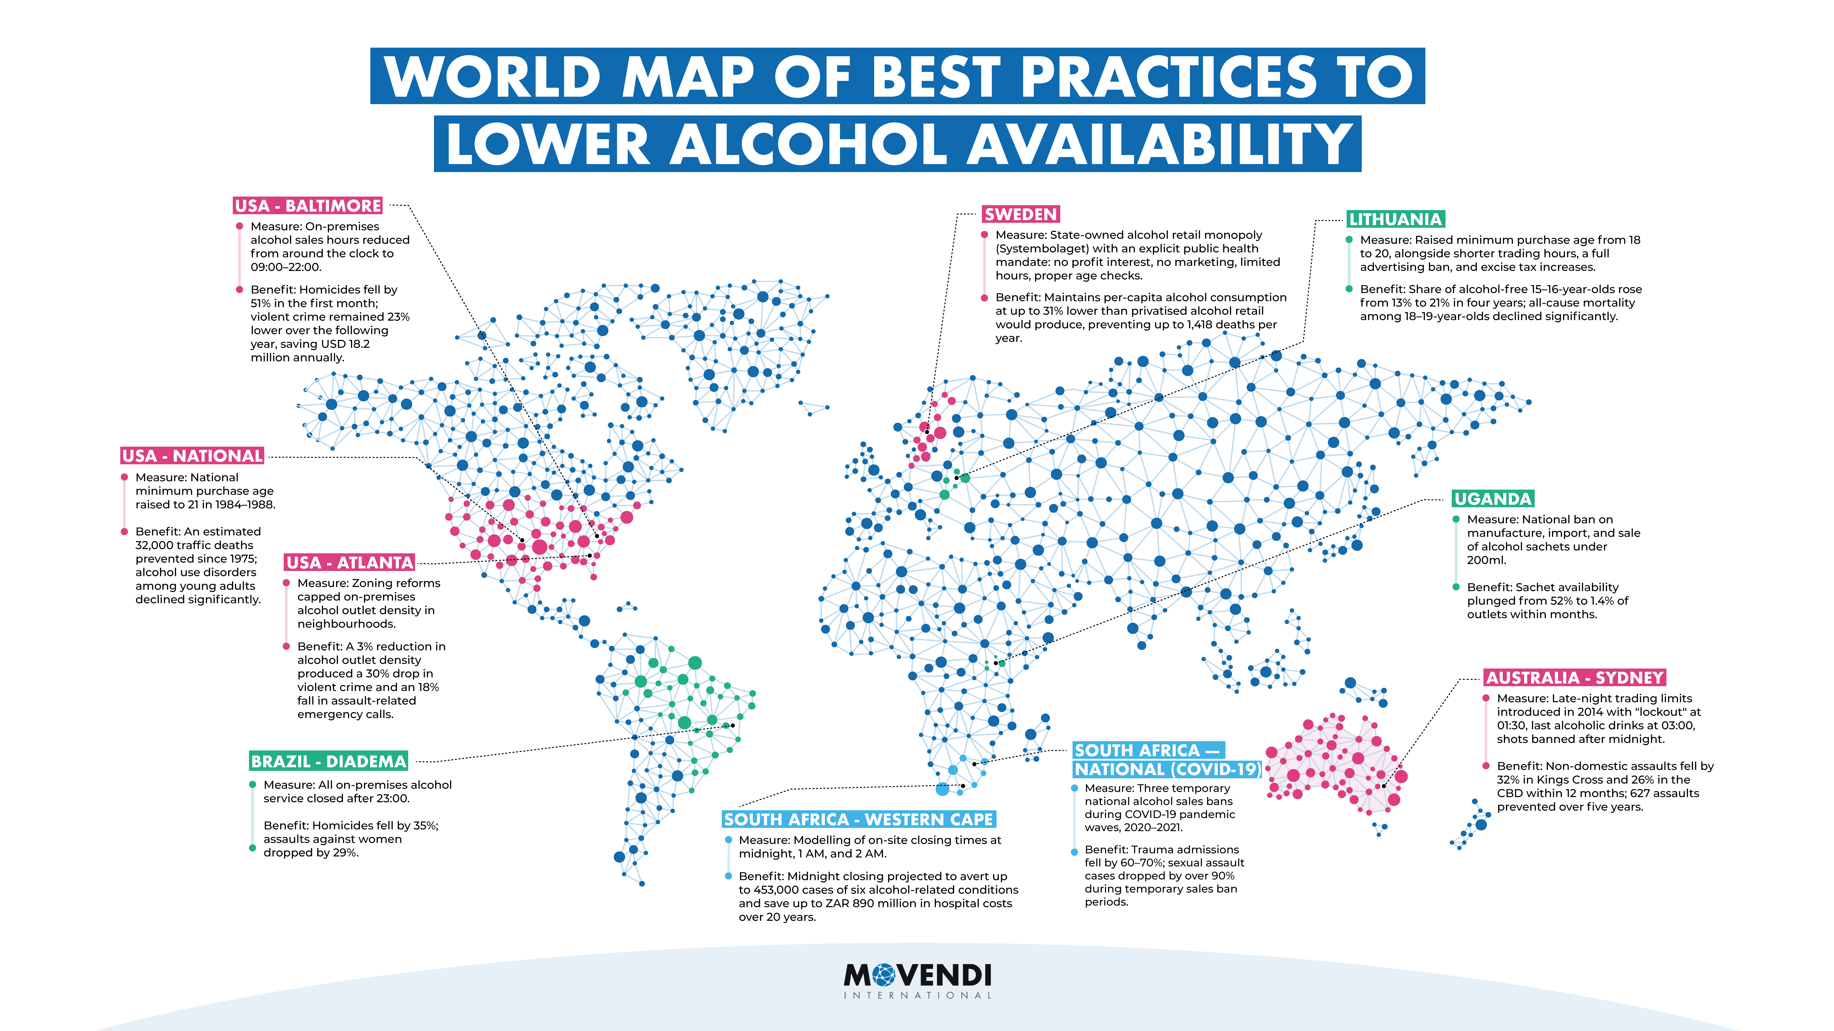

Slide 64

THANK YOU
Development through alcohol policy
www.movendi.ngo
maik.duennbier@movendi.ngo

